Slide 1


An Efficient Conformer-Based Tri-Modal Architecture for Continuous Indian Sign Language Recognition
Guided By – Professor Dr. Utpal Biswas
By Iqbal Shaikh & Anupam Acharyya

Slide 2
Challenge of Sign Language AI
Natural signing is fluid, generating rapid coarticulation and blurry "movement epenthesis" between words.
Traditional 2D Convolutional Models suffer from "Motion Blindness" and completely fail to capture trajectories.
Massive 3D-CNNs hit a "Hardware Wall" because they analyze useless background pixels, causing severe computational overhead.

Slide 3








Computational Hardware Wall
Memory Overhead
Spatial Redundancy
Sequential Latency
Processing dense RGB video tensors across the temporal axis requires massive memory bandwidth, imposing strict hardware limits on consumer web browsers.
Pixel-based models waste computing power optimizing weights for static background environments (walls, clothing) instead of rapid linguistic hand cues.
Traditional recurrent models (LSTMs) must process data frame-by-frame sequentially, creating deep inference lag that prevents real-time streaming.

Slide 4


Tri-Modal Omni-Dataset
Continuous Sentences
Isolated Words
Static Alphabets
195 videos capturing natural movement epenthesis. Its low volume inherently risks data starvation if used alone.
200 isolated videos engineered to act as a crucial Curriculum Learning bridge, smoothing mathematical transitions.
1,300 images establishing uncompromising geometric anchors for identifying precise fingerspelling micro-movements.

Slide 5
MediaPipe Spatial Compression
Bypassing massive RGB video files, the pipeline extracts a highly compressed 1086-dimensional skeletal coordinate array per frame:
Pose: 33 points (66 dims) mapping macro-kinematics.
FaceMesh: 468 points (936 dims) for non-manual grammatical markers.
Hands: 42 points (84 dims) tracking micro-geometry.
This completely dismantles the hardware wall by removing 99% of computational bloat.

Slide 6


Resolving Format Mismatches
The Dimensionality Crisis
Static Sequence Simulation
Deep sequence networks demand dimensional homogeneity. Attempting to mix 2D static alphabet images with 3D continuous videos completely violates convolutional tensor requirements, causing immediate matrix multiplication crashes during the training loops.
To safely merge formats, our pipeline processes static images once, then mathematically duplicates the 1086-dimensional feature vector 15 times along the temporal axis. This flawlessly synthesizes a static 0.5-second video tensor.

Slide 7
Geometric Data Augmentation
Linear Time Stretching: The temporal length of training tensors is dynamically scaled (0.85x to 1.15x) to simulate radically varying human signing speeds.
Gaussian Jitter: We inject random noise directly into the 1086 coordinates to artificially mimic motion blur, sensor glitches, and poor webcams.
Overcoming Data Starvation: These random spatial variations force the neural network to memorize relative geometry rather than absolute pixel locations.
Mathematical Result: Prevents overfitting, stabilizes gradients, and significantly drops the Error Rate on unseen test data.

Slide 8
The Efficient ConSignformer
A lightweight Convolution-augmented Transformer tailored for real-time sequence translation.

Slide 9





Architecture Core Components
Self-Attention
1D Convolution
Classification
4 attention heads analyze the overarching global temporal alignment across the entire sentence simultaneously, providing deep sequence context.
A wide receptive field acts as an aggressive local feature extractor, mathematically smoothing out chaotic "movement epenthesis".
A dense Feed Forward module and Log-Softmax classification head project the compressed features into 278 unique vocabulary tokens.

Slide 10
Beam Search Decoding
50
Holistic Context Evaluation
Instead of relying on a fragile Greedy Decoder that guesses frame-by-frame, the Beam Search evaluates the cumulative mathematical probability of 50 simultaneous sentence paths.
Active Hypotheses (k=50)
By evaluating the whole sequence, the network dynamically recovers from blurry frames and seamlessly substitutes structurally valid grammar.

Slide 11
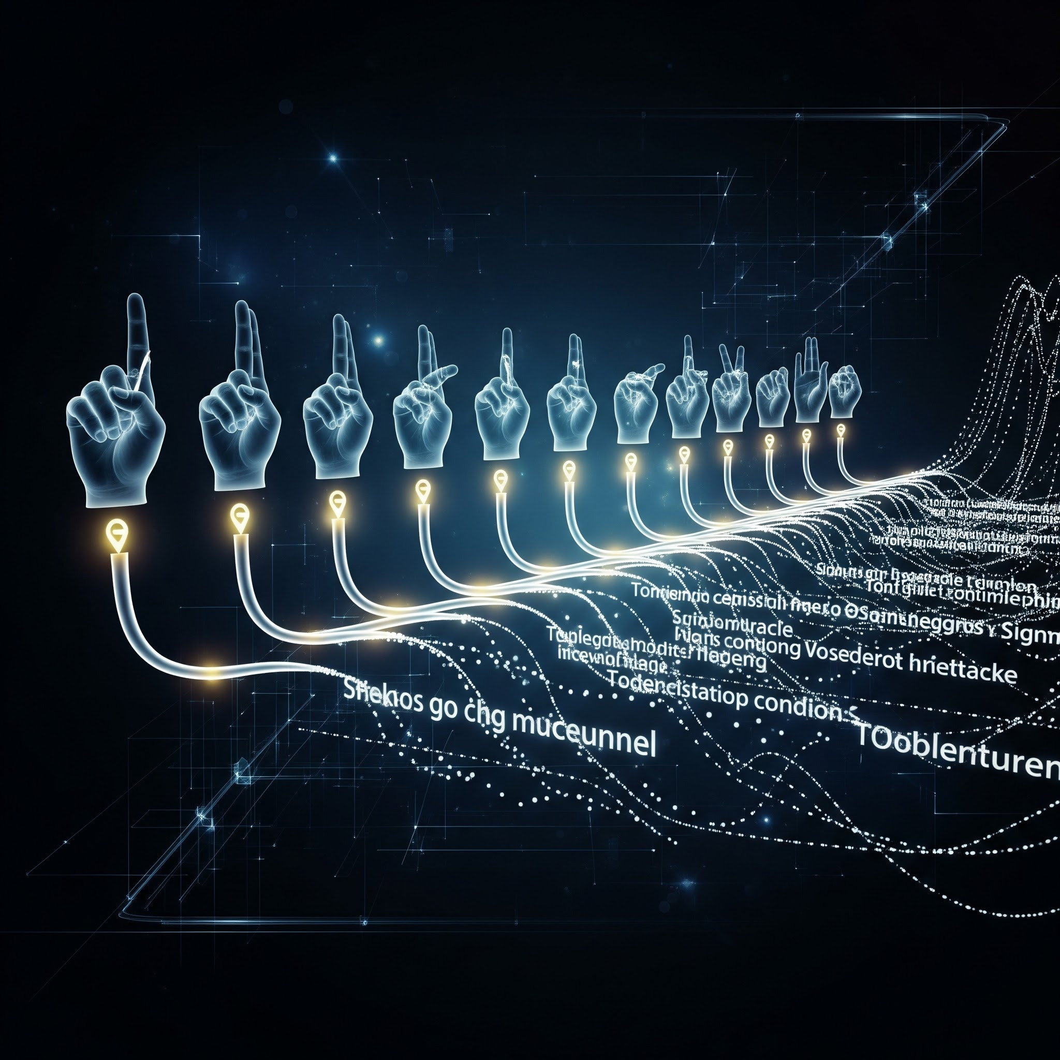
Curriculum Synergy Framework
Unrestricted multi-modal fusion initially triggered severe Catastrophic Forgetting, washing out continuous video gradients.
We enforced strict programmatic dataset caps (maximum 7 simulations per static letter class).
Isolated words acted as a Curriculum Learning bridge to smooth out "Vocabulary Shock".
The AI learned to identify the spatial boundaries of isolated signs before tackling high-speed continuous sentences.

Slide 12
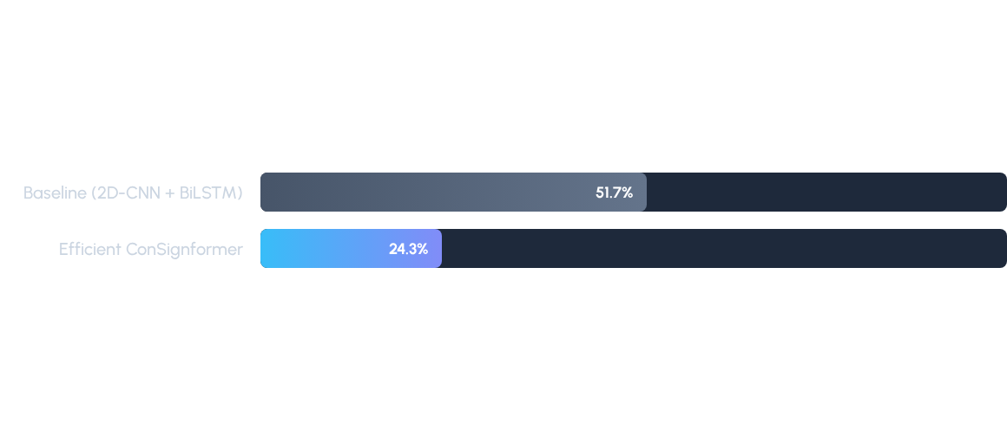

Ablation Study & WER Results
The final ConSignformer drastically outperforms the baseline. A 24.3% WER proves the architecture successfully maps spatial-temporal geometry into sound English syntax without hallucinating strings of text.

Slide 13
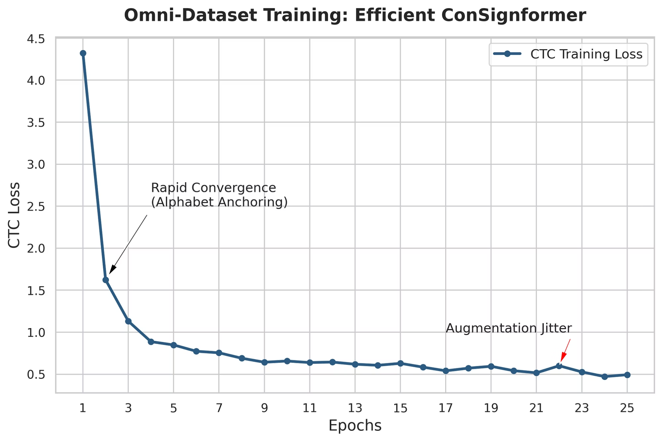
Training Convergence Trends

Slide 14
Real-Time Web Deployment
The highly compressed mathematical weights are successfully exported and deployed into an interactive Streamlit web application.
Utilizing a live WebRTC camera feed, it instantly extracts coordinates and outputs text with virtually zero latency.
The system natively supports both live video and static photo uploads on consumer hardware.

Slide 15
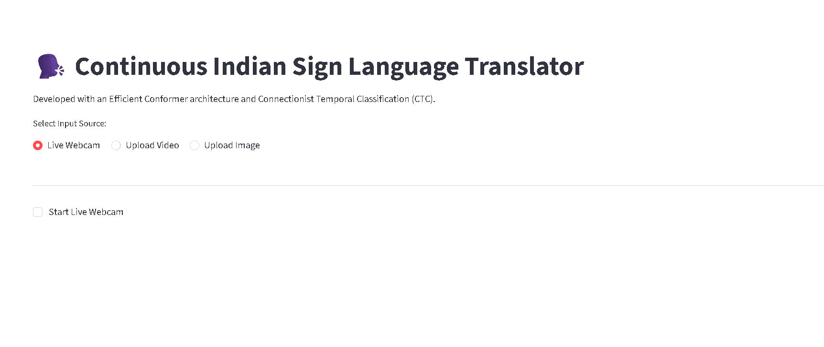

Slide 16

Conclusion & Future Scope
Conclusion
Future Scaling
Ultimate Goal
Coordinate-based Conformers reliably process continuous sign language without 3D‑CNN overhead, enabling browser-capable models.
Migrate to high-tier cloud GPUs to process the full 118k-sequence iSign dataset and remove remaining visual collisions.
Integrate Text-to-Speech (TTS) for an end-to-end Sign-to-Speech accessibility pipeline.

Slide 17
Thank You

